Slide 1
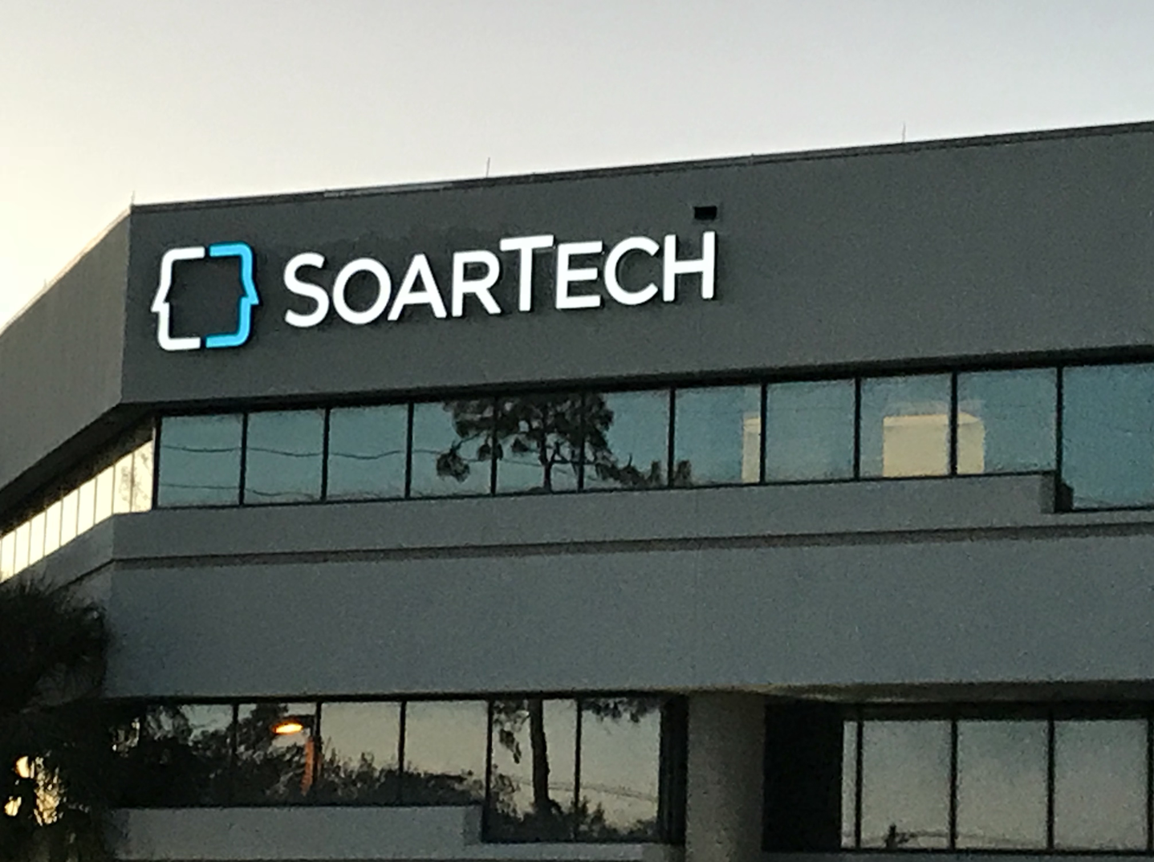
2019 Company Update

Slide 2
Soar Technology, Inc.
It’s not the capabilities of the AI. It’s the capabilities of the human with the AI.
Our Vision: Be the recognized leader in Artificial Intelligence(AI) that works in concert with humans
Our Mission: We believe artificial intelligence has the potential to make humans safer and better. Soar Technology provides the technology that enables humans and AI to work in close concert keeping humans safe and making them more informed, better prepared, smarter and more capable.
 | Gov’t | Commercial
Research | SoarTech | SoarAuto
Non-Research | SoarTech Engineering Division | Glidin’ 2

Slide 3
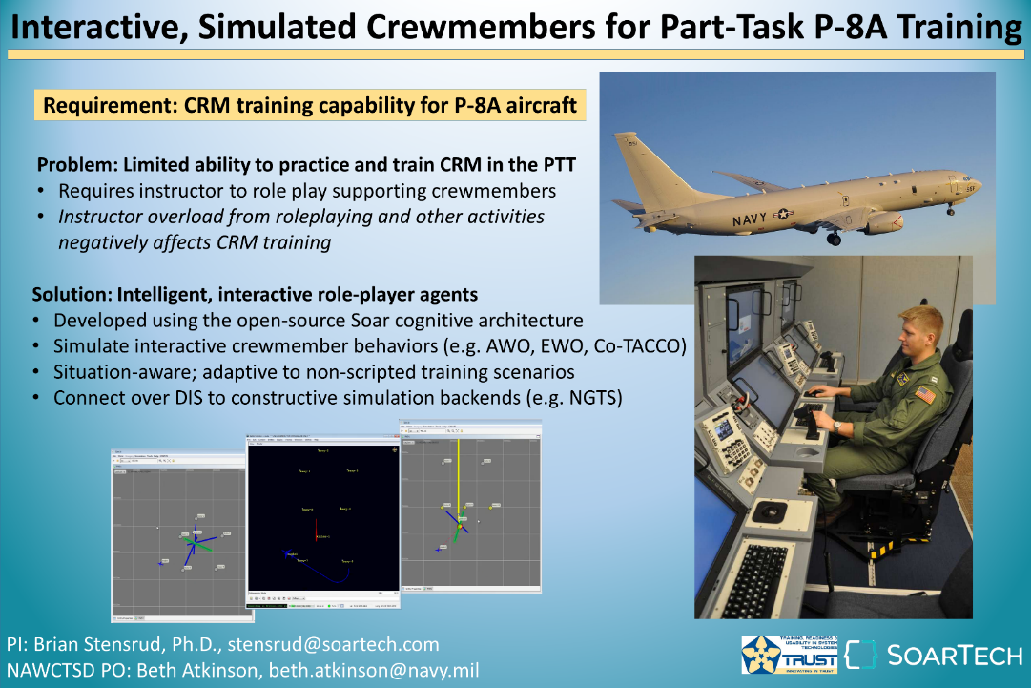

Slide 4
FireHack competition at AFRL

Slide 5

SoarTech has a wholly-owned subsidiary, ”SoarAuto” focusing on AI applications in transportation for the commercial market.
Human-like autonomy that learns to anticipate
SoarAuto provides the benefit of experienced and trusted autonomy:
Quickly adapt to special cases through experience
Anticipate safety critical situations by:
Reasoning about uncertain, unsensed, and unexpected (U³)risks
Reasoning further in advance
Rapidly expand autonomy, blending heuristic and learned knowledge
Share experiences, accelerating deployment of robust autonomy
Fully transparent reasoning, including learned knowledge

Slide 6
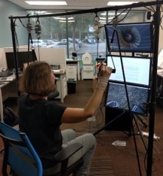
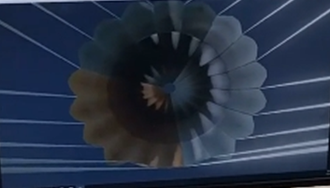

Skyfall Parachute Descent Trainer

Slide 7
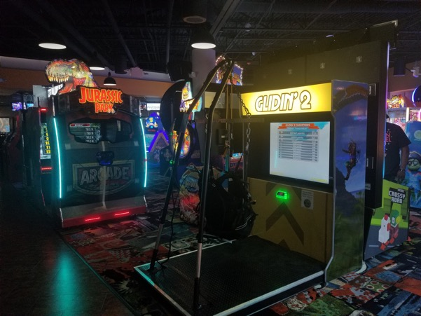
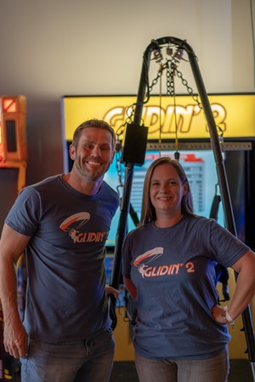
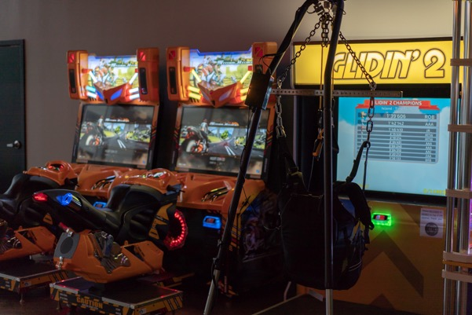
Glidin’ 2

